Slide 1
Value signals in the orbitofrontal cortex incorporate reference-dependent news utility
*slides
Brenden Eum
Zeynep Enkavi
John O’Doherty
Antonio Rangel

Slide 2
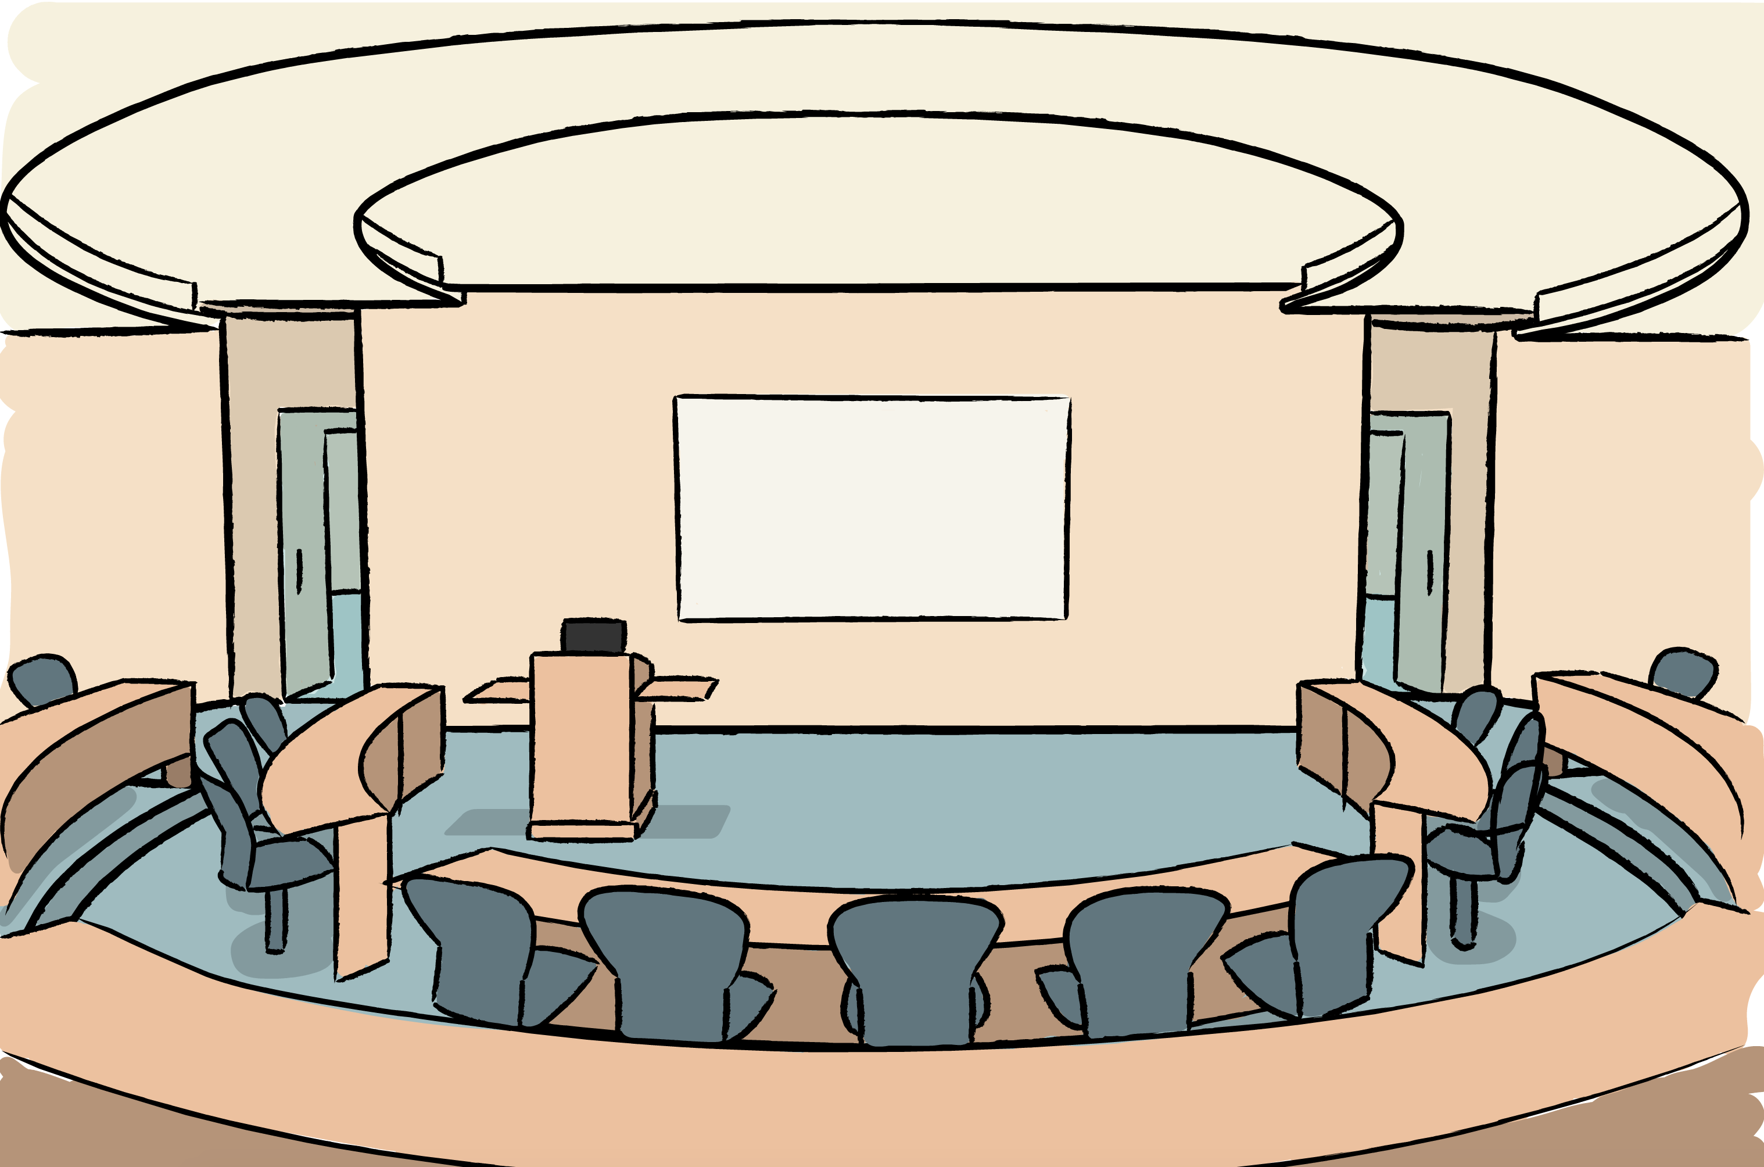


There’s gonna be pizza at the CBIC Talk 🔥🔥🔥
It’s unlikely there will be pizza at the CBIC Talk
¯\_(ツ)_/¯

Slide 3
Experienced utility…
at time of news
at time of consumption

Slide 4
Experienced utility…
at time of news
at time of consumption
Surprise Experienced Utility (sEU)
Consumption Experienced Utility (cEU)
Surprise Experienced Utility

Slide 5
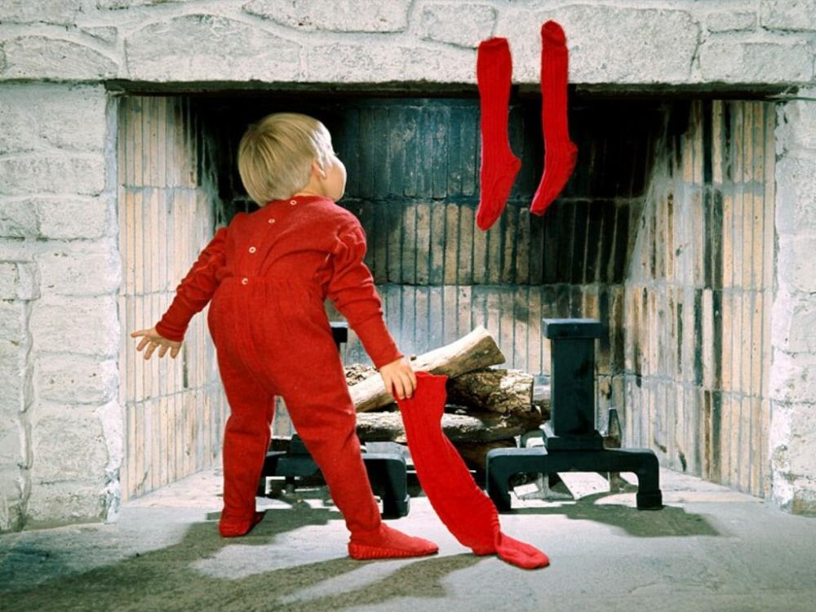
sEU is NOT anticipation
at time of news
at time of consumption

Slide 6
Is experienced utility only influenced by outcomes, or also by beliefs?

Slide 7
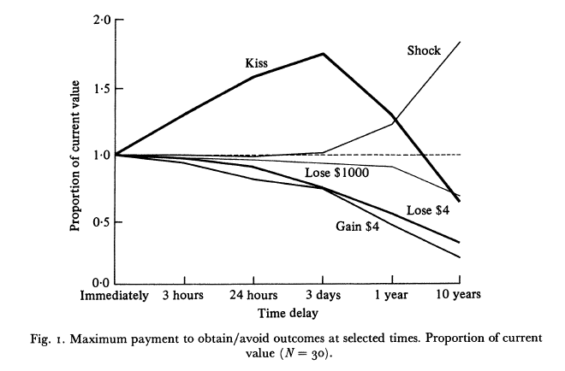
Anticipation
Lowenstein (1987, Econ J)

Slide 8

News Utility: Household Investor Behavior
Financial “ostrich” behavior after market declines.
Sicherman, Loewenstein, Seppi, & Utkus (2015, Rev Financ Stud)
Bilias, Geogarakos, & Haliassos (2010, JMCB)
If investors experience loss-averse news utility, then they have an incentive to ignore their portfolio if they expect bad news.
Pagel (2018, Econometrica)

Slide 9
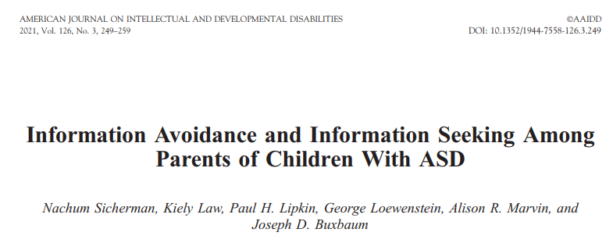
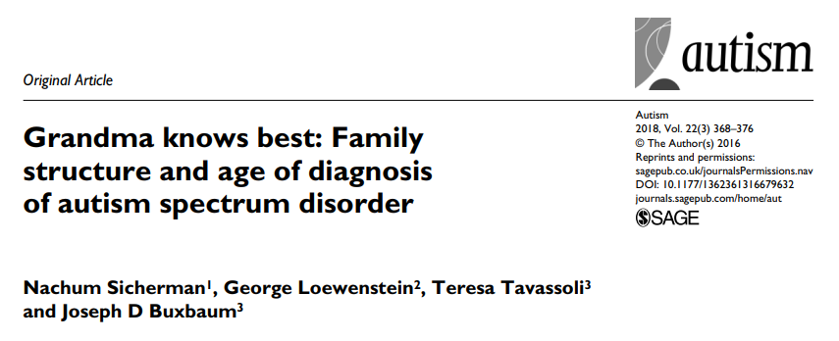
News Utility: Early detection in Autism Diagnosis
“Many parents avoid seeking help to find a diagnosis for their child, even though they sense something might be wrong. They often ignore signs of a larger problem and look the other way, making the role of close family members and friends vital to accelerating diagnosis and helping a child’s condition.”
- Nachum Sicherman (2017)
Frequent interaction with grandma reduces age of ASD diagnosis by 5.18 months.

Slide 10


News Utility: Anecdotal

Slide 11
Beliefs and Preferences
Disappointment aversion [Bell (1985, Oper Res), Loomes & Sugden (1986, Rev Econ Stud)]
Reference-dependent preferences [Koszegi & Rabin (2006 QJE, 2007 AER)]
Reference-dependent news utility [Koszegi & Rabin (2009, AER)]
Information preferences and attention [Golman & Lowenstein (2016, Decis)]

Slide 12
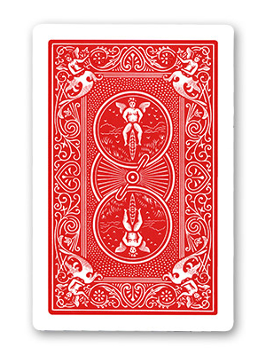
Testing Information Preferences
Falk & Zimmerman (2022, Manag Sci)
immediately after picking
right before consumption period

Slide 13
Testing Information Preferences
Falk & Zimmerman (2022, Manag Sci)
immediately after picking
right before consumption period
DISTRACTION

Slide 14
Testing Information Preferences
Falk & Zimmerman (2022, Manag Sci)
all at once
immediately after picking

Slide 15
Testing Information Preferences
Falk & Zimmerman (2022, Manag Sci)
all at once
immediately after picking
Experimental evidence supports loss-averse news utility [Koszegi & Rabin (2009, AER)].

Slide 16
Testing Information Preferences
Falk & Zimmerman (2022, Manag Sci)
Only used aversive outcomes.
Does not give any insight on the functional form of news utility.
Is news utility reference-dependent, as in Koszegi & Rabin (2009, AER)?

Slide 17
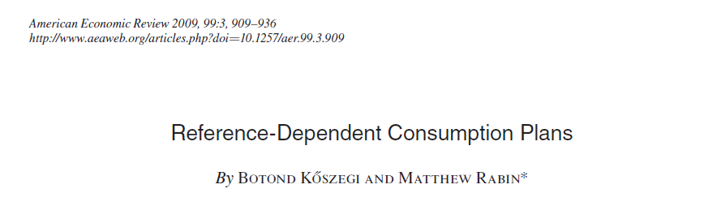
“KR news utility”

Slide 18
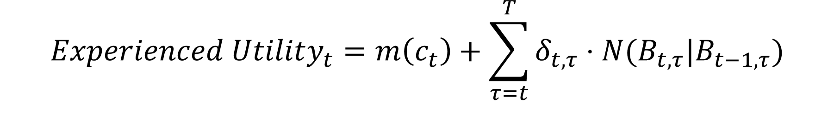
$$Experienced Utility_{t}=m\left(c_{t}\right)+\sum_{τ=t}^{T}{δ_{t,τ}⋅N(B_{t,τ}|B_{t−1, τ})}$$
cEU
discounting
changes in beliefs about future consumption
beliefs inherited from time $t−1$ about consumption at time $τ$
Let N be some function of the difference in expected consumption
in the form of a “universal gain-loss utility function”:
Bowman, Minehart, and Rabin (1999, J Econ Behav Organ)
Kahneman and Tversky (1979, Econometrica)

Slide 19
$$Experienced Utility_{t}=m\left(c_{t}\right)+\sum_{τ=t}^{T}{δ_{t,τ}⋅N(B_{t,τ}|B_{t−1, τ})}$$
cEU
sEU
This implies a preference for good news now about consumption in the future.
Gain-loss utility is also applicable at time of consumption.

Slide 20

But wait a second…
Isn’t sEU just TD RPE?
No!
all at once
immediately after picking
$$≽$$

Slide 21
Goals
Neuroscience
Where are these preferences for information encoded in the brain?
Behavioral Economics
Are they encoded the same way that economists have postulated?
Does news utility hold with appetitive outcomes, not just aversive outcomes?

Slide 22
Hypothesis: Value signals in the OFC incorporate reference-dependent news utility

Slide 23
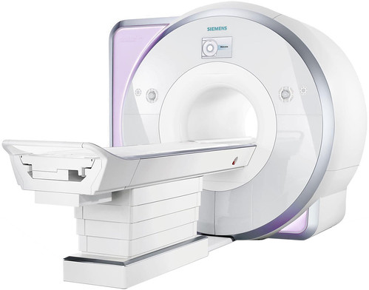

Viewing task
144 trials
2 blocks
Fractal choice task
24 trials
1 block
Rating task
72 trials
1 block
25 mins
2.5 mins
9 mins

Slide 24
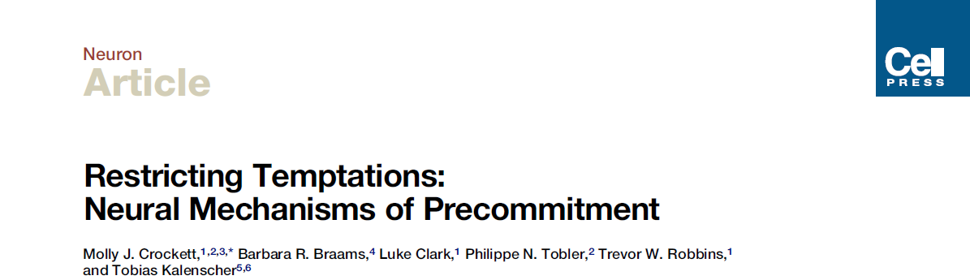
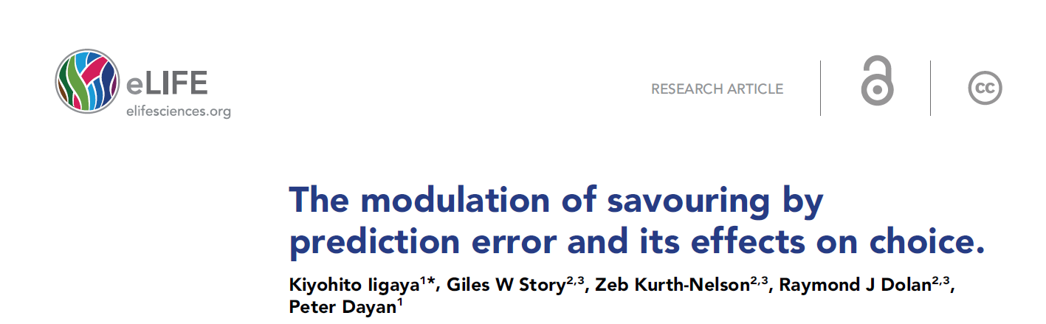
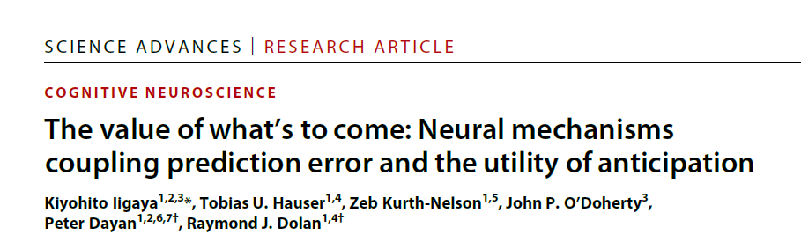
Subjects and Stimulus Set
Heterosexual male subjects.
72 images of women in lingerie.
Crockett et al. (2013), Sescouse et al. (2013), and informal confirmation from Kiyo that heterosexual male vmPFC lights up upon presentation of these types of stimuli.

Slide 25
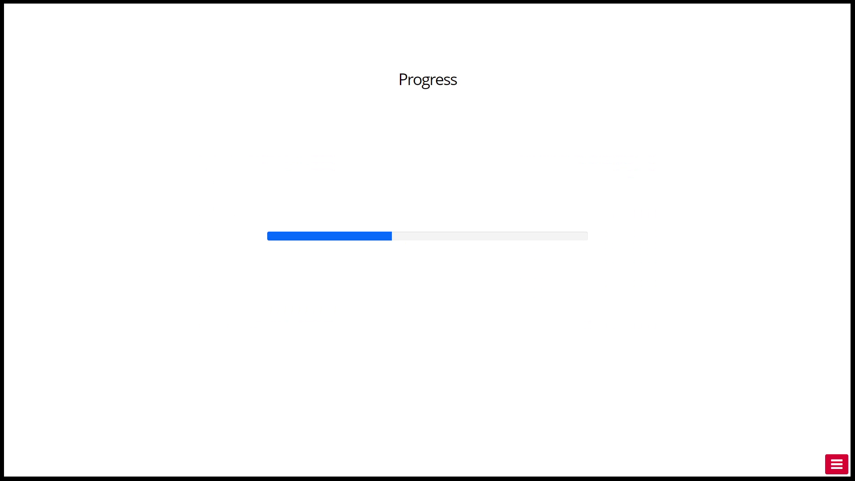

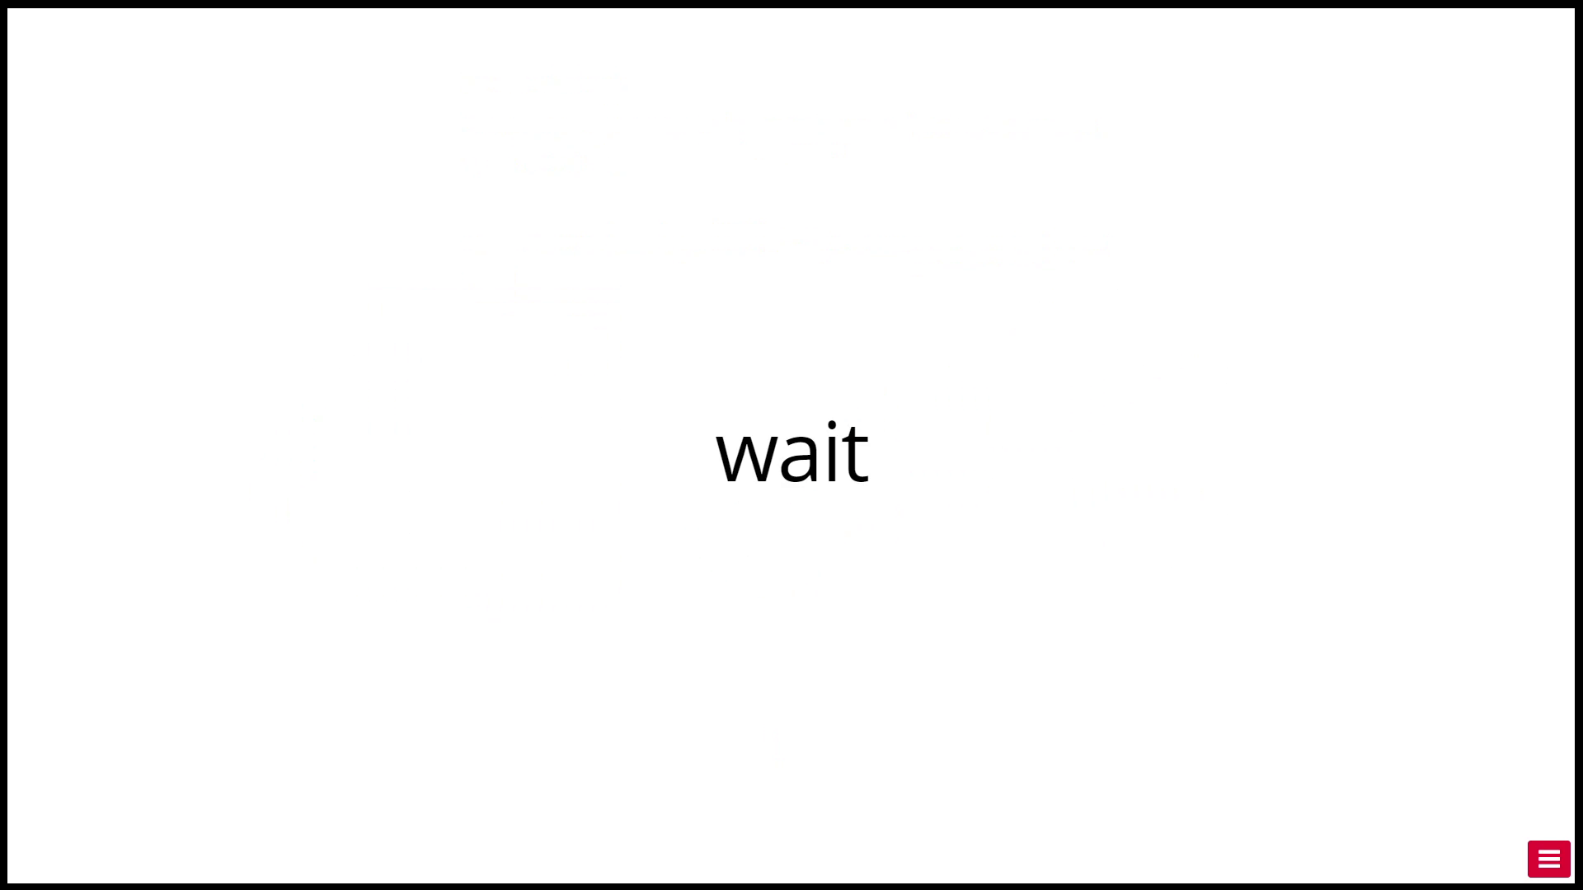



Viewing Task
Progress
Unif(1,5) s
Information
1 s
Wait
{1,2,3,4} s
Outcome
2 s
Feedback
(part of the 2 s)

Slide 26
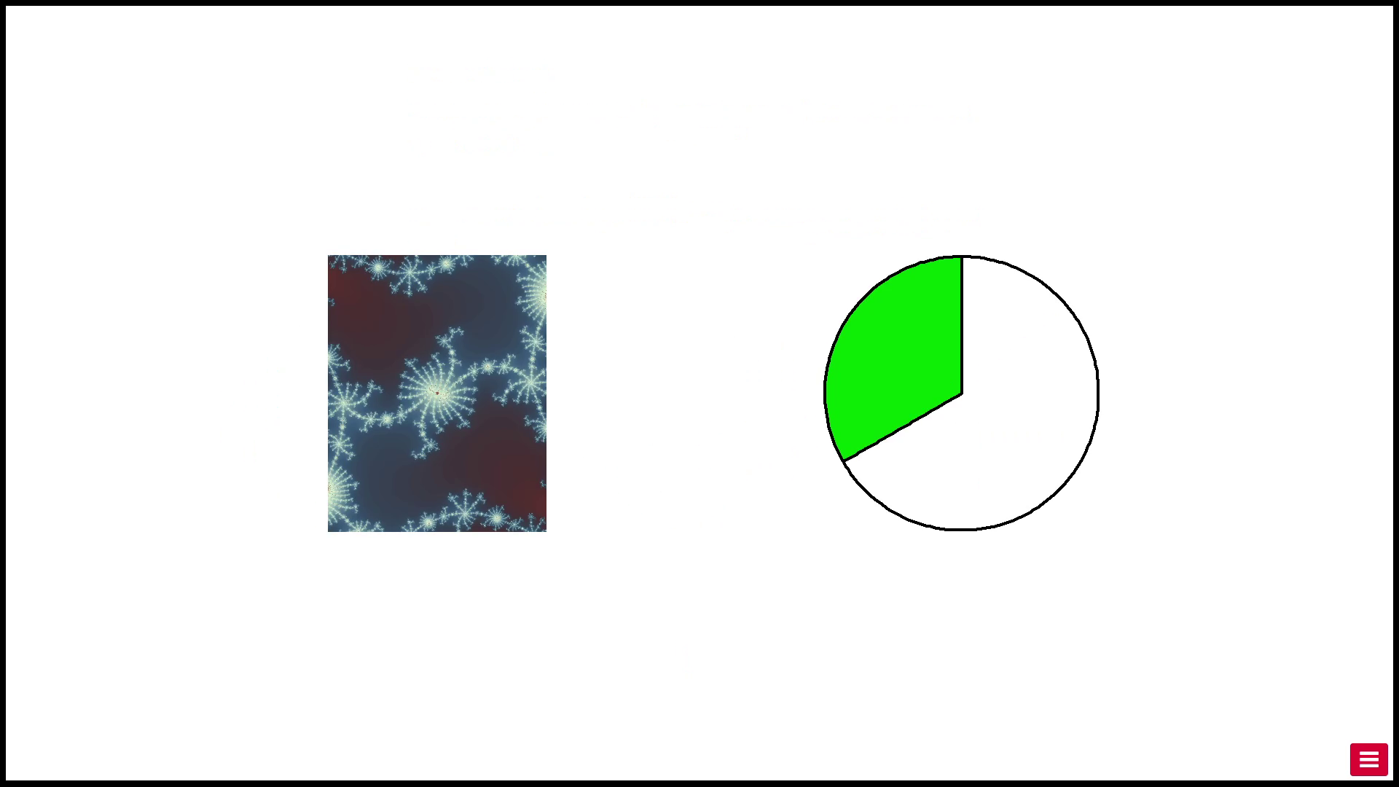
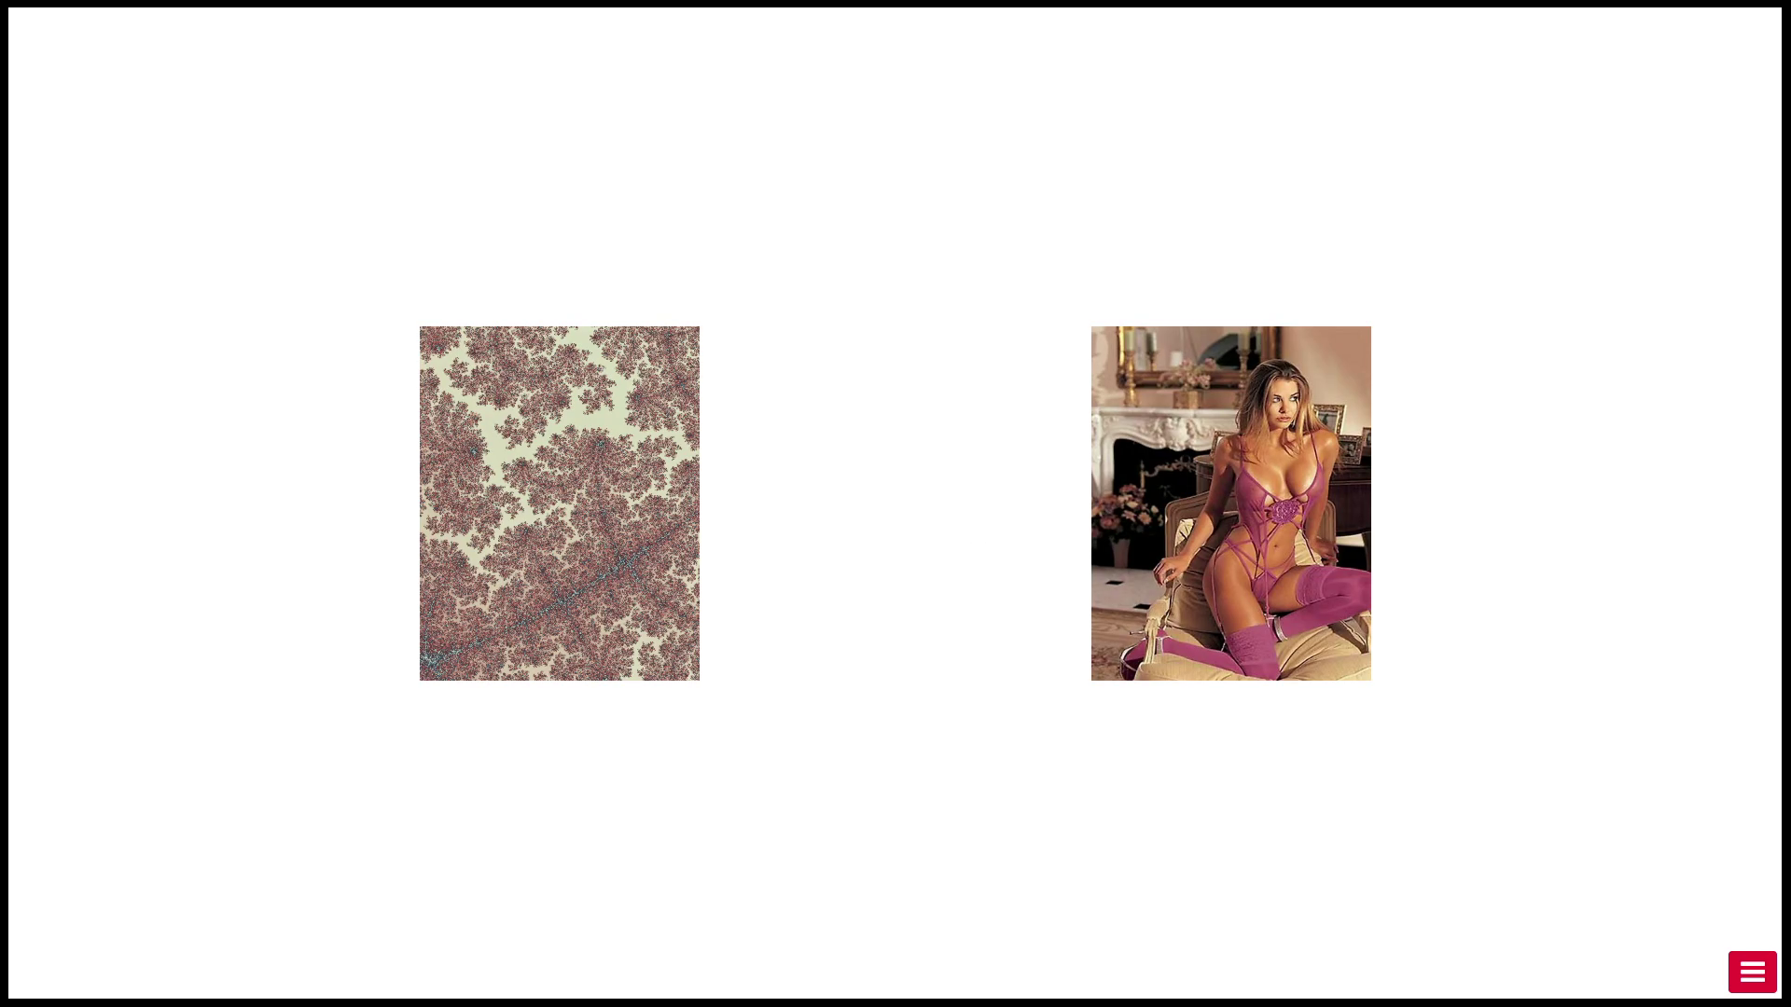
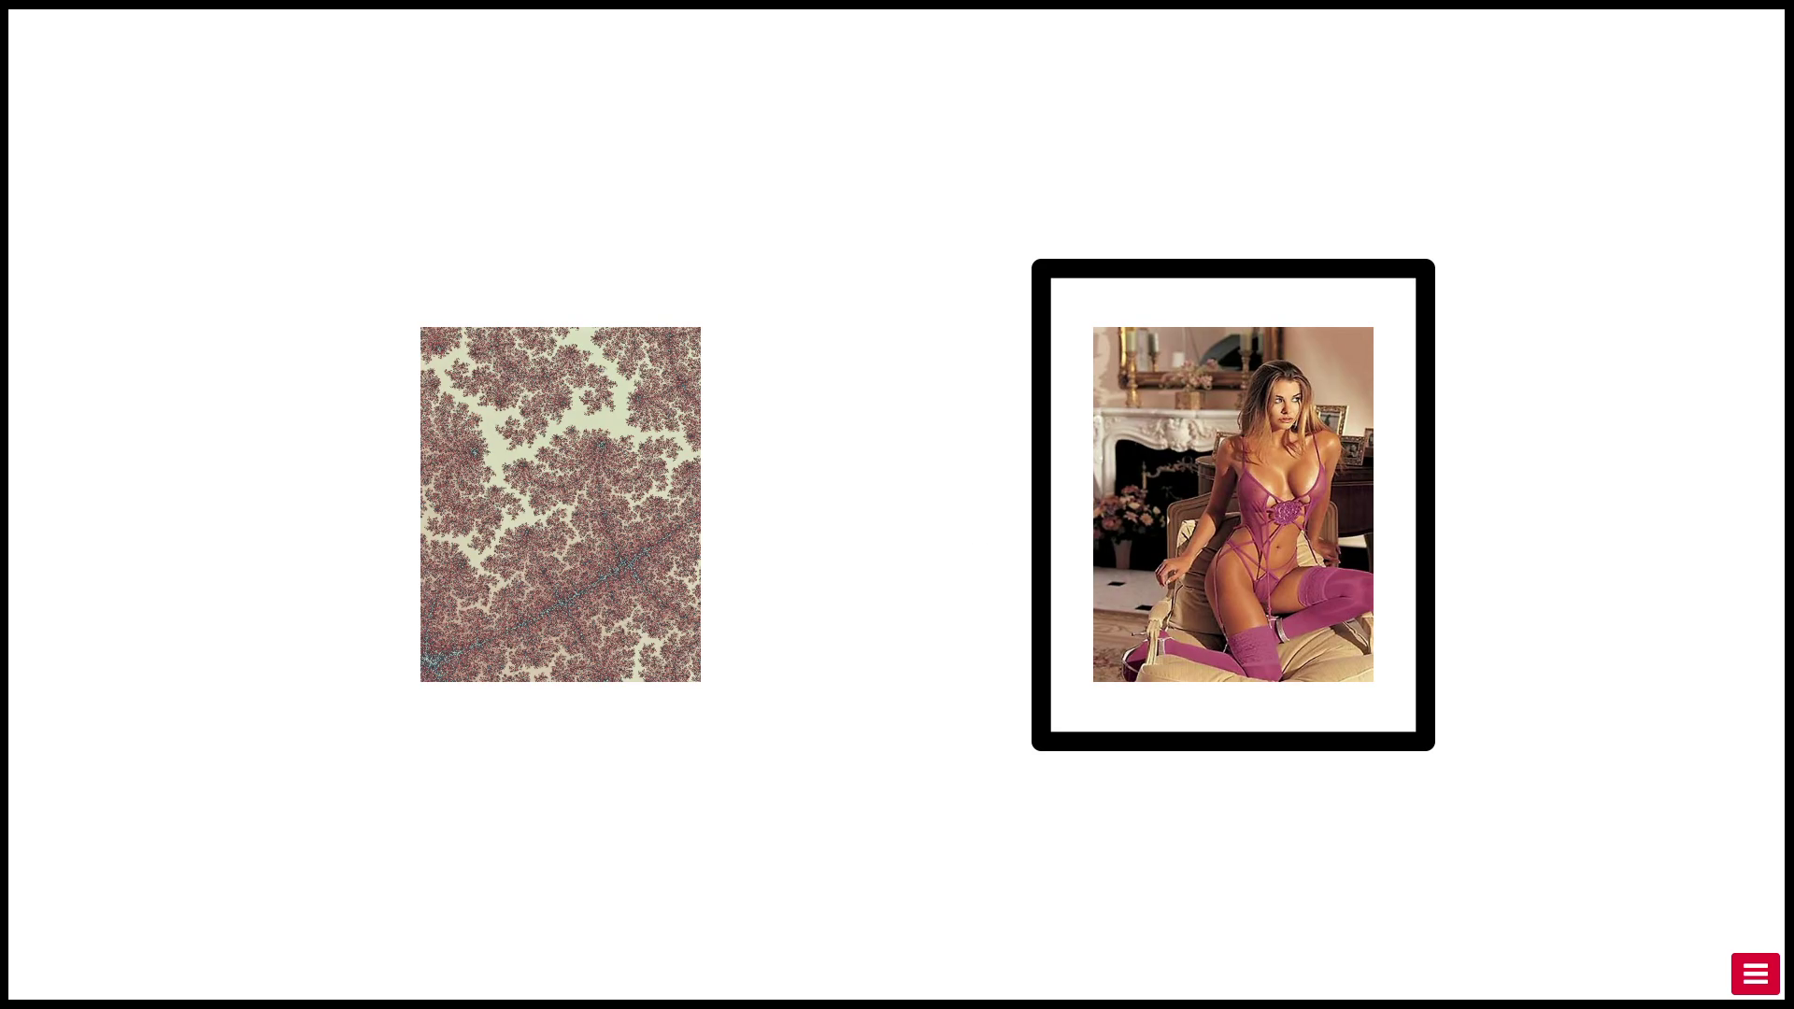
Viewing Task
Progress
Unif(1,5) s
Information
1 s
Wait
{1,2,3,4} s
Outcome
2 s
Feedback
(part of the 2 s)

Slide 27
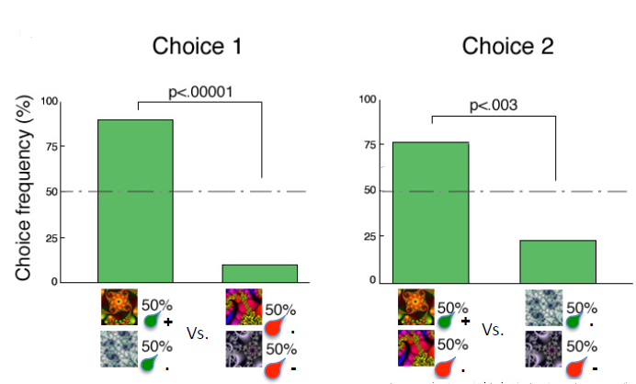
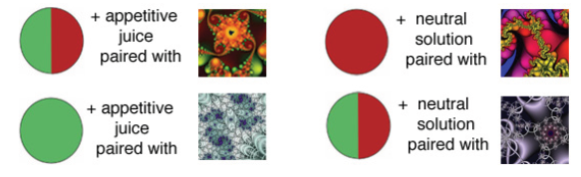
Simultaneous Conditioning
Bushong, Rabin, Camerer, & Rangel (wp)

Slide 28
Precommitment to High Quality Data
Drop if…
accuracy in Viewing Task is <90%.

Slide 29
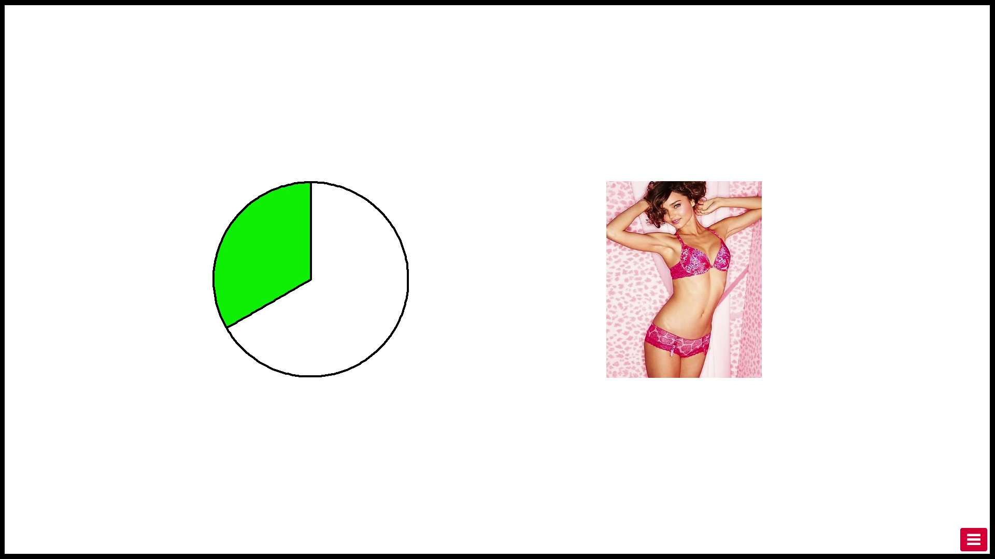
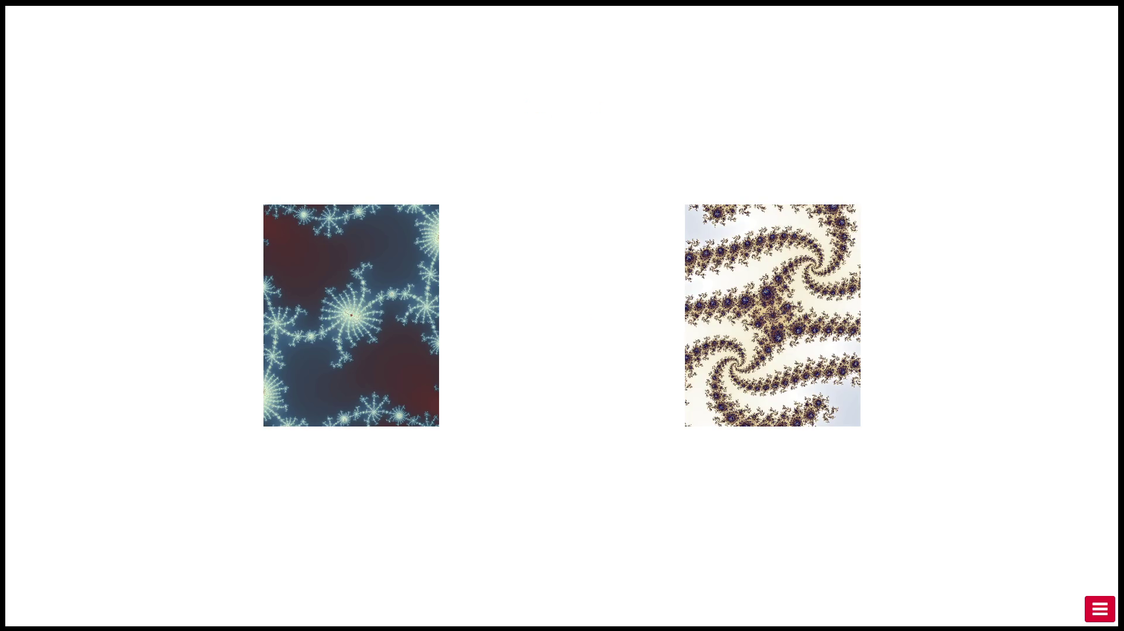
Fractal Choice Task
Progress
1 s
Outcome
2 s
Choice
Free RT
24 times
24 times

Slide 30
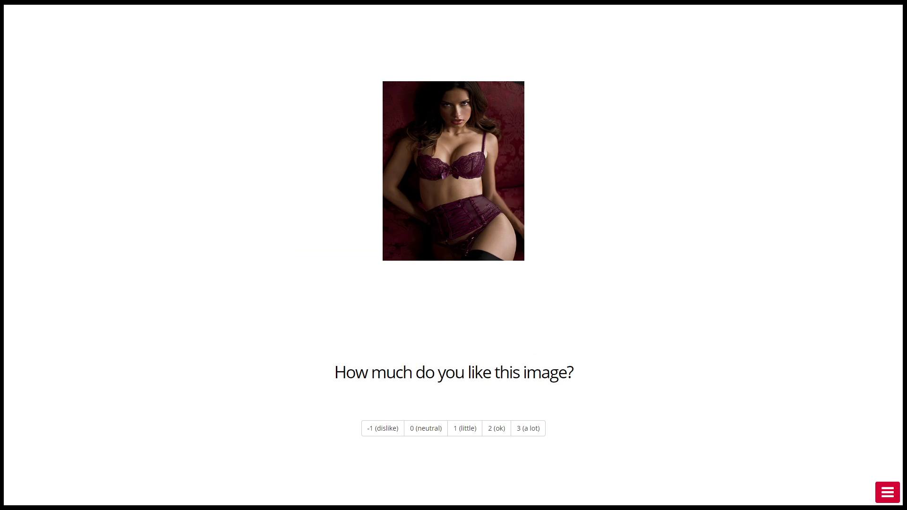
Rating Task
Progress
1 s
Discrete Rating from -1 to 3
Free RT

Slide 31
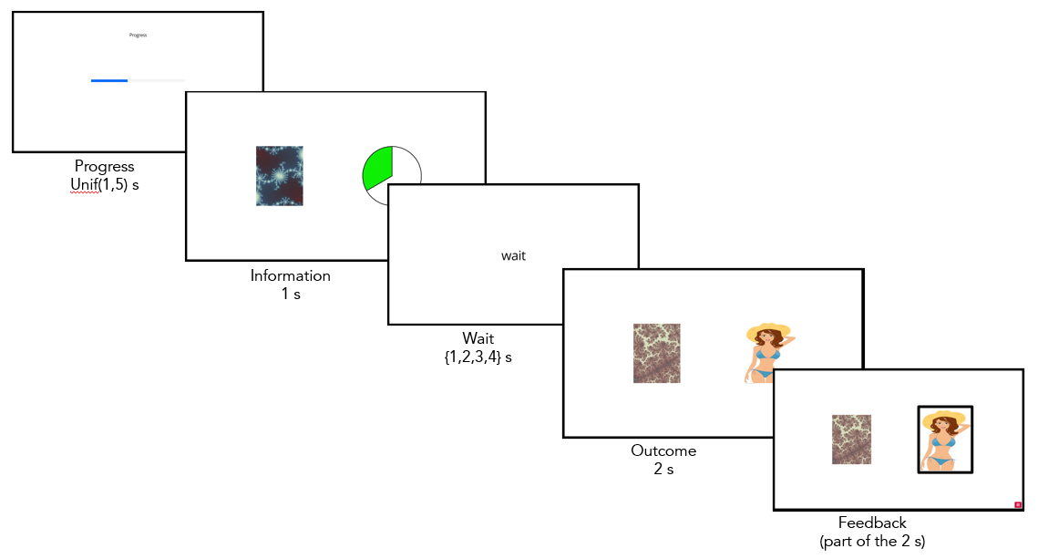
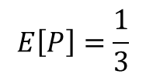
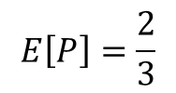
Viewing Task Conditions
Pie Chart | 1 | 2/3 | 1/3 | 0
Block H | ✔ | ✔ | ✔
Block L |  | ✔ | ✔ | ✔
$$E\left[P\right]=\frac{2}{3}$$
$$E\left[P\right]=\frac{1}{3}$$

Slide 32
Viewing Task Conditions
Pie Chart | 1 | 2/3 | 1/3 | 0
Block H | Good | Neutral | Bad
Block L |  | Good | Neutral | Bad

Slide 33
Viewing Task Conditions
Pie Chart | 1 | 2/3 | 1/3 | 0
Block H | Good | Neutral | Bad
Block L |  | Good | Neutral | Bad

Slide 34
Viewing Task Conditions
Pie Chart | 1 | 2/3 | 1/3 | 0
Block H | Good | Neutral | Bad
Block L |  | Good | Neutral | Bad

Slide 35
Viewing Task Conditions
Pie Chart | 1 | 2/3 | 1/3 | 0
Block H | Good | Neutral | Bad
Block L |  | Good | Neutral | Bad

Slide 36
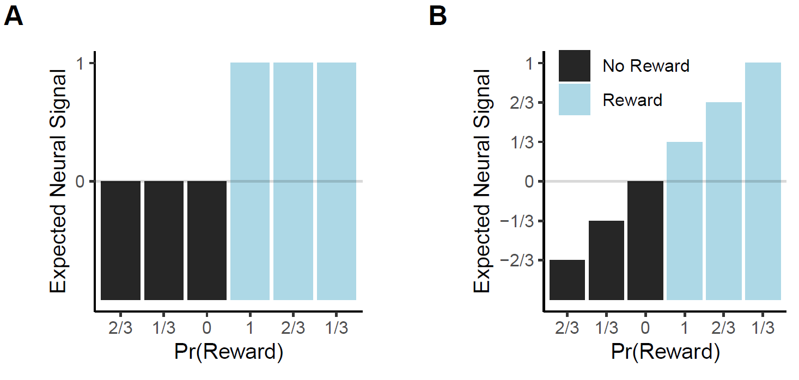
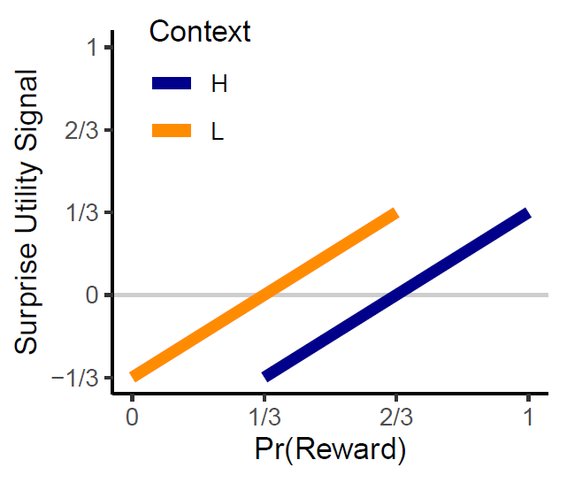
Viewing Task: Expected BOLD signal in OFC at time of news

Slide 37

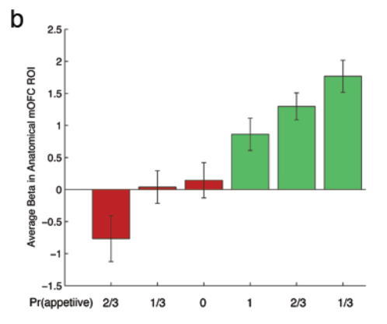
Viewing Task: Expected BOLD signal in OFC at time of consumption
Bushong, Rabin, Camerer, & Rangel (wp)

Slide 38
What are you testing with the fractal choice task?
Context | H |  |  | L
Probability | 1 | 2/3 | 1/3 | 2/3 | 1/3 | 0
cEU | 0 | 0 | 0 | 0 | 0 | 0
cEU + sEU | 0+1/3 | 0+0 | 0-1/3 | 0+1/3 | 0+0 | 0-1/3
@ time of news
Outcome | Reward |  |  | No Reward
Probability | 1 | 2/3 | 1/3 | 2/3 | 1/3 | 0
cEU | 1 | 1 | 1 | 0 | 0 | 0
cEU + sEU | 1+0 | 1+1/3 | 1+2/3 | 0-2/3 | 0-1/3 | 0+0
@ time of consumption

Slide 39
Model Predictions
Context | H |  |  | L
Probability | 1 | 2/3 | 1/3 | 2/3 | 1/3 | 0
EU = cEU | 0 | 0 | 0 | 0 | 0 | 0
EU = cEU + sEU | 1/3 | 0 | -1/3 | 1/3 | 0 | -1/3
Outcome | Reward |  |  | No Reward
Probability | 1 | 2/3 | 1/3 | 2/3 | 1/3 | 0
EU = cEU | 1 | 1 | 1 | 0 | 0 | 0
EU = cEU + sEU | 1 | 1 1/3 | 1 2/3 | -2/3 | -1/3 | 0
1 | F(Reward, P=1/3) | > | F(Reward, P=1)
2 | F(No Reward, P=0) | > | F(No Reward, P=1/3)
3 | F(H, P=1) | > | F(H, P=1/3)
4 | F(L, P=1/3) | > | F(H, P=1/3)
5 | F(L, P=1/3) | = | F(No Reward, P=0)
6 | F(H, P=1/3) | = | F(No Reward, P=1/3)

Slide 40
Model Predictions
Context | H |  |  | L
Probability | 1 | 2/3 | 1/3 | 2/3 | 1/3 | 0
EU = cEU | 0 | 0 | 0 | 0 | 0 | 0
EU = cEU + sEU | 1/3 | 0 | -1/3 | 1/3 | 0 | -1/3
Outcome | Reward |  |  | No Reward
Probability | 1 | 2/3 | 1/3 | 2/3 | 1/3 | 0
EU = cEU | 1 | 1 | 1 | 0 | 0 | 0
EU = cEU + sEU | 1 | 1 1/3 | 1 2/3 | -2/3 | -1/3 | 0
1 | F(Reward, P=1/3) | > | F(Reward, P=1)
2 | F(No Reward, P=0) | > | F(No Reward, P=1/3)
3 | F(H, P=1) | > | F(H, P=1/3)
4 | F(L, P=1/3) | > | F(H, P=1/3)
5 | F(L, P=1/3) | = | F(No Reward, P=0)
6 | F(H, P=1/3) | = | F(No Reward, P=1/3)

Slide 41
Model Predictions
Context | H |  |  | L
Probability | 1 | 2/3 | 1/3 | 2/3 | 1/3 | 0
EU = cEU | 0 | 0 | 0 | 0 | 0 | 0
EU = cEU + sEU | 1/3 | 0 | -1/3 | 1/3 | 0 | -1/3
Outcome | Reward |  |  | No Reward
Probability | 1 | 2/3 | 1/3 | 2/3 | 1/3 | 0
EU = cEU | 1 | 1 | 1 | 0 | 0 | 0
EU = cEU + sEU | 1 | 1 1/3 | 1 2/3 | -2/3 | -1/3 | 0
1 | F(Reward, P=1/3) | > | F(Reward, P=1)
2 | F(No Reward, P=0) | > | F(No Reward, P=1/3)
3 | F(H, P=1) | > | F(H, P=1/3)
4 | F(L, P=1/3) | > | F(H, P=1/3)
5 | F(L, P=1/3) | = | F(No Reward, P=0)
6 | F(H, P=1/3) | = | F(No Reward, P=1/3)

Slide 42
Model Predictions
Context | H |  |  | L
Probability | 1 | 2/3 | 1/3 | 2/3 | 1/3 | 0
EU = cEU | 0 | 0 | 0 | 0 | 0 | 0
EU = cEU + sEU | 1/3 | 0 | -1/3 | 1/3 | 0 | -1/3
Outcome | Reward |  |  | No Reward
Probability | 1 | 2/3 | 1/3 | 2/3 | 1/3 | 0
EU = cEU | 1 | 1 | 1 | 0 | 0 | 0
EU = cEU + sEU | 1 | 1 1/3 | 1 2/3 | -2/3 | -1/3 | 0
1 | F(Reward, P=1/3) | > | F(Reward, P=1)
2 | F(No Reward, P=0) | > | F(No Reward, P=1/3)
3 | F(H, P=1) | > | F(H, P=1/3)
4 | F(L, P=1/3) | > | F(H, P=1/3)
5 | F(L, P=1/3) | = | F(No Reward, P=0)
6 | F(H, P=1/3) | = | F(No Reward, P=1/3)

Slide 43
Model Predictions
Context | H |  |  | L
Probability | 1 | 2/3 | 1/3 | 2/3 | 1/3 | 0
EU = cEU | 0 | 0 | 0 | 0 | 0 | 0
EU = cEU + sEU | 1/3 | 0 | -1/3 | 1/3 | 0 | -1/3
Outcome | Reward |  |  | No Reward
Probability | 1 | 2/3 | 1/3 | 2/3 | 1/3 | 0
EU = cEU | 1 | 1 | 1 | 0 | 0 | 0
EU = cEU + sEU | 1 | 1 1/3 | 1 2/3 | -2/3 | -1/3 | 0
1 | F(Reward, P=1/3) | > | F(Reward, P=1)
2 | F(No Reward, P=0) | > | F(No Reward, P=1/3)
3 | F(H, P=1) | > | F(H, P=1/3)
4 | F(L, P=1/3) | > | F(H, P=1/3)
5 | F(L, P=1/3) | = | F(No Reward, P=0)
6 | F(H, P=1/3) | = | F(No Reward, P=1/3)

Slide 44
Model Predictions
Context | H |  |  | L
Probability | 1 | 2/3 | 1/3 | 2/3 | 1/3 | 0
EU = cEU | 0 | 0 | 0 | 0 | 0 | 0
EU = cEU + sEU | 1/3 | 0 | -1/3 | 1/3 | 0 | -1/3
Outcome | Reward |  |  | No Reward
Probability | 1 | 2/3 | 1/3 | 2/3 | 1/3 | 0
EU = cEU | 1 | 1 | 1 | 0 | 0 | 0
EU = cEU + sEU | 1 | 1 1/3 | 1 2/3 | -2/3 | -1/3 | 0
1 | F(Reward, P=1/3) | > | F(Reward, P=1)
2 | F(No Reward, P=0) | > | F(No Reward, P=1/3)
3 | F(H, P=1) | > | F(H, P=1/3)
4 | F(L, P=1/3) | > | F(H, P=1/3)
5 | F(L, P=1/3) | = | F(No Reward, P=0)
6 | F(H, P=1/3) | = | F(No Reward, P=1/3)

Slide 45
Behavioral Pilot Results (N=10)

Slide 46
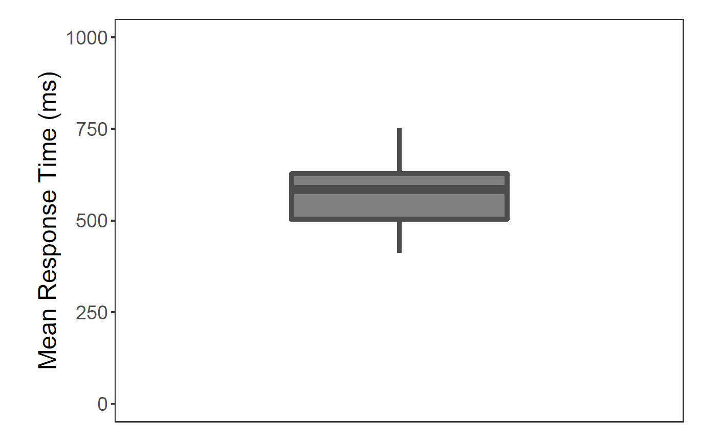
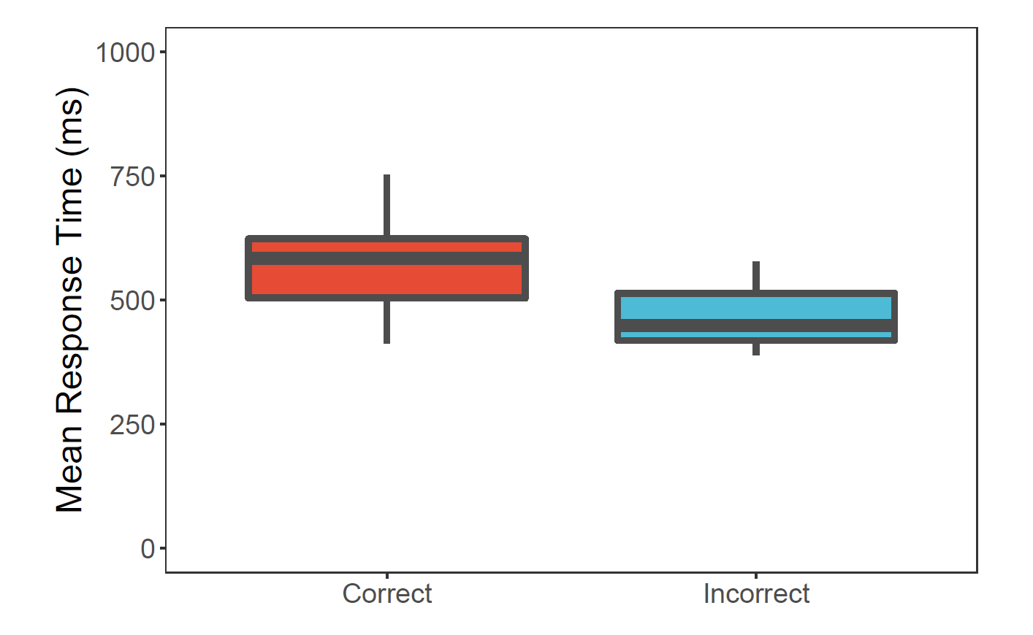
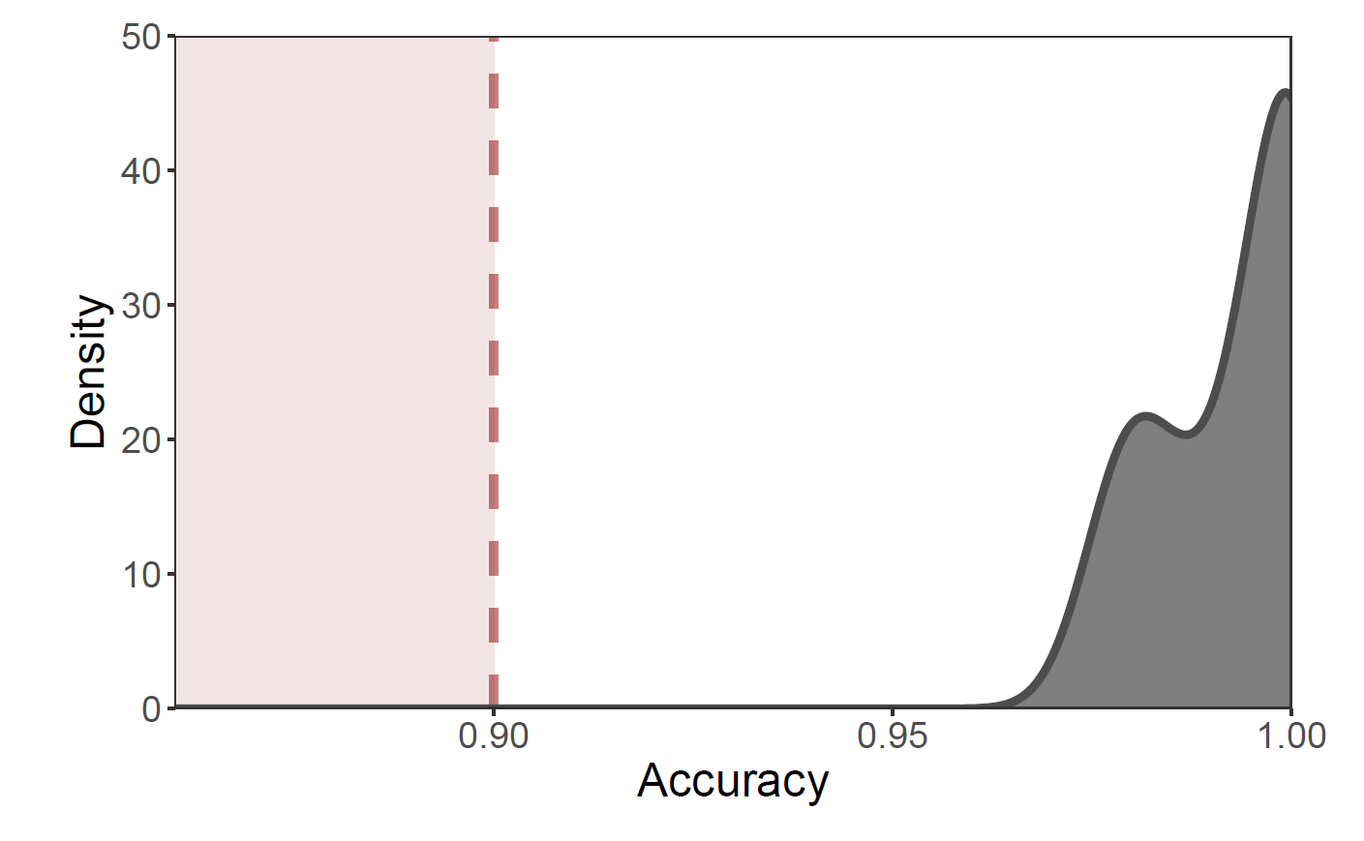
Viewing Task: Basic Psychometrics
Dropped 1 out of 10 subjects.

Slide 47
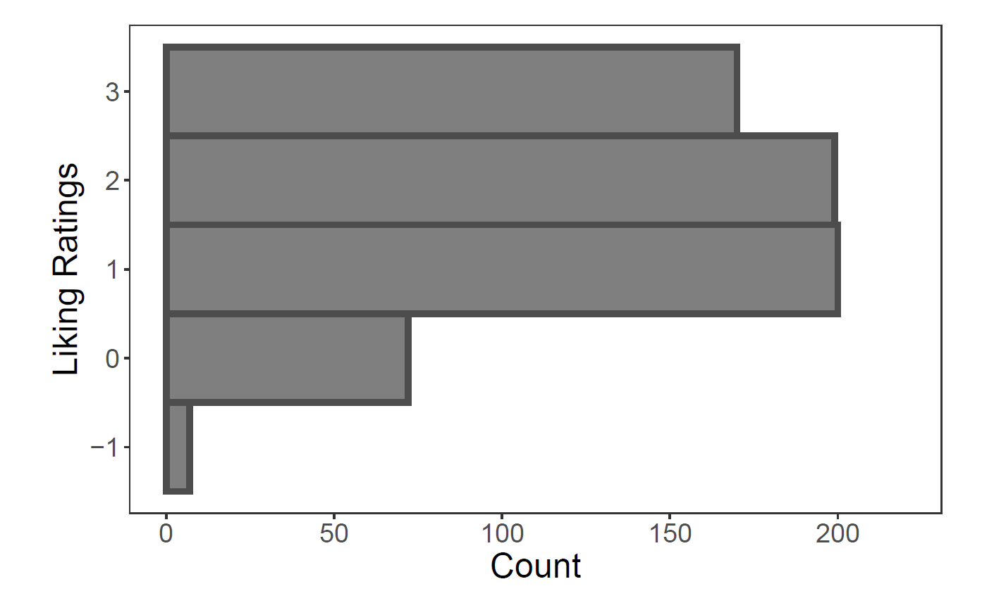
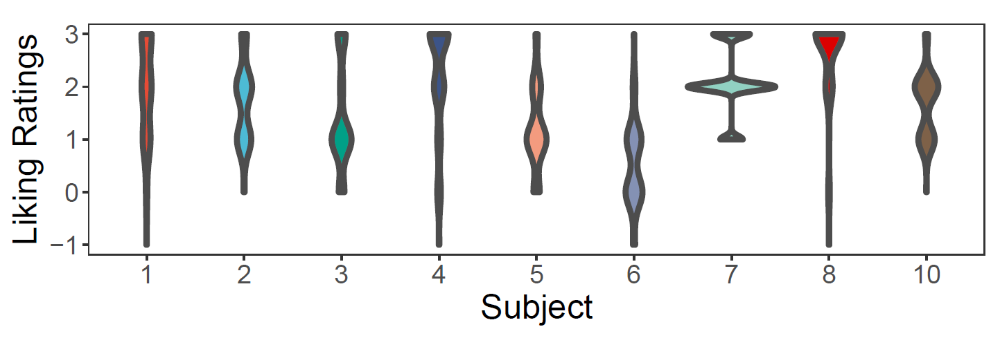
Rating Task: Liking Ratings

Slide 48
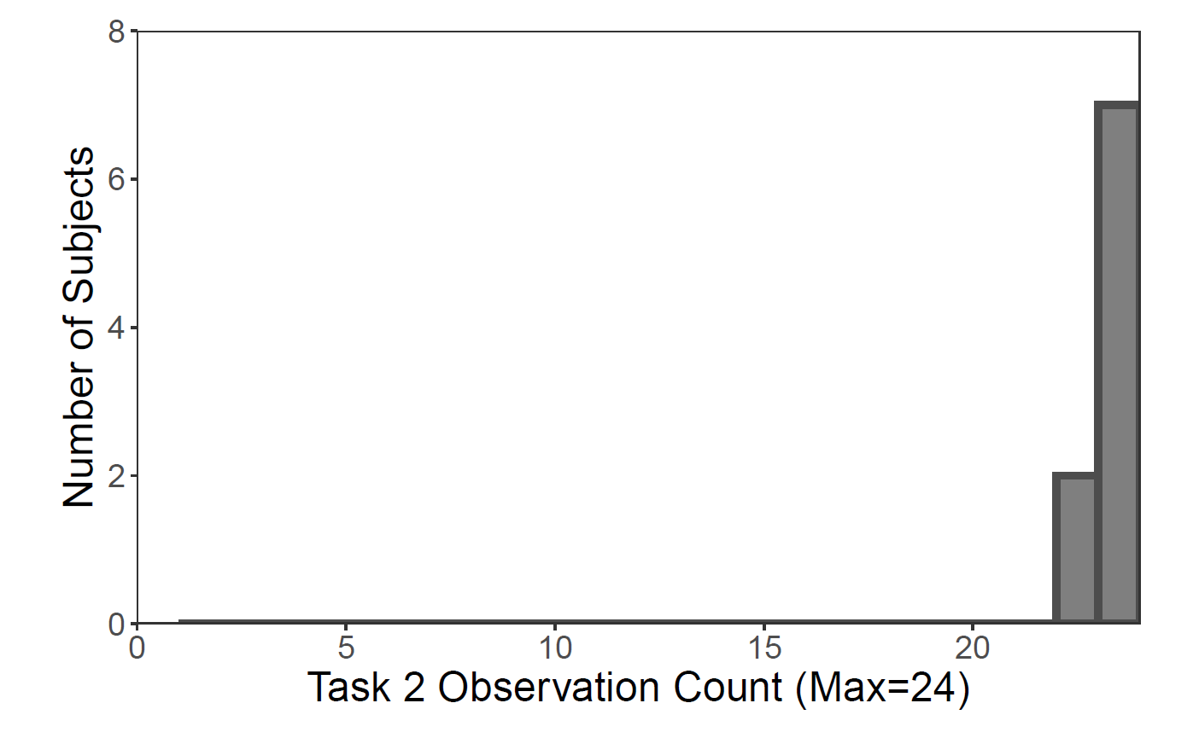
Fractal Choice Task: Quality Check

Slide 49
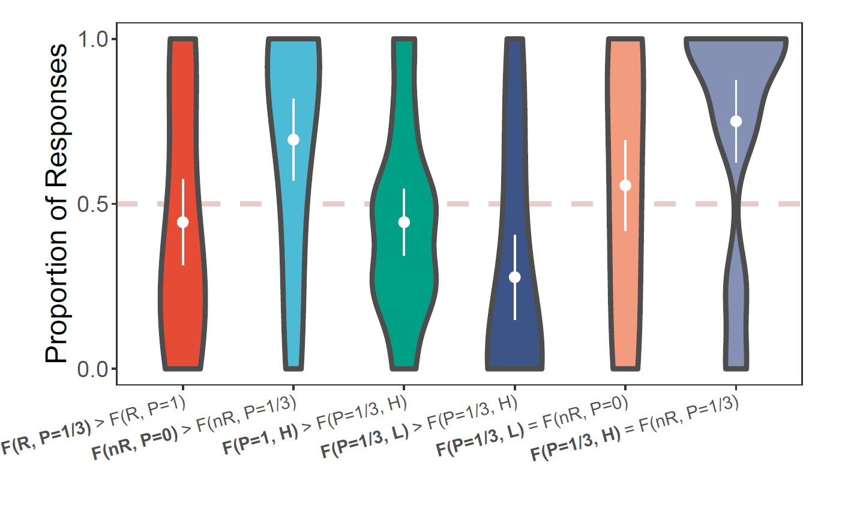
Fractal Choice Task: Model Predictions

Slide 50
sEU vs. Anticipation Utility

Slide 51
sEU vs. Anticipation Utility
Fixation
Unif(1,5) s
Information
1 s
Wait
{1,2,3,4} s
sEU
no sEU
Outcome
2 s
sEU
Feedback
(part of the 2 s)

Slide 52
Anticipation Utility (aEU)
Iigaya et al. (2016, 2020)
aEU only depends on the probability of getting reward, not the context.
Context | H |  |  | L
Probability | 1 | 2/3 | 1/3 | 2/3 | 1/3 | 0
cEU | 0 | 0 | 0 | 0 | 0 | 0
cEU + sEU | 1/3 | 0 | -1/3 | 1/3 | 0 | -1/3
cEU + aEU | 1 | 2/3 | 1/3 | 2/3 | 1/3 | 0

Slide 53
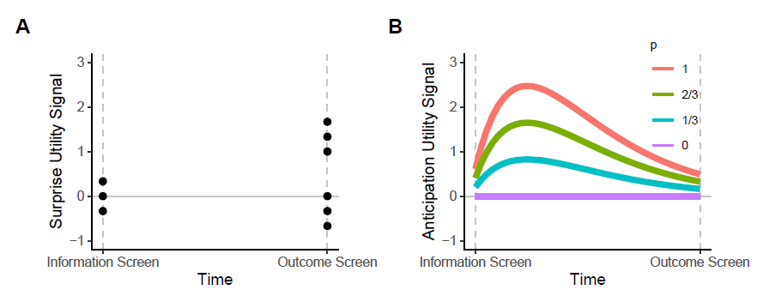
Anticipation Utility (aEU)
aEU is decreasing in proximity to reward (e.g. distance or time), unlike sEU which is a transient experience at the time of news and at the time of consumption.

Slide 54
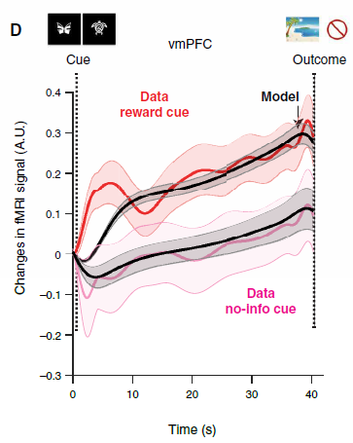
Anticipation Utility (aEU)
aEU is decreasing in proximity to reward (e.g. distance or time), unlike sEU which is a transient experience at the time of news and at the time of consumption.
Iigaya et al. (2020, Sci Adv)

Slide 55
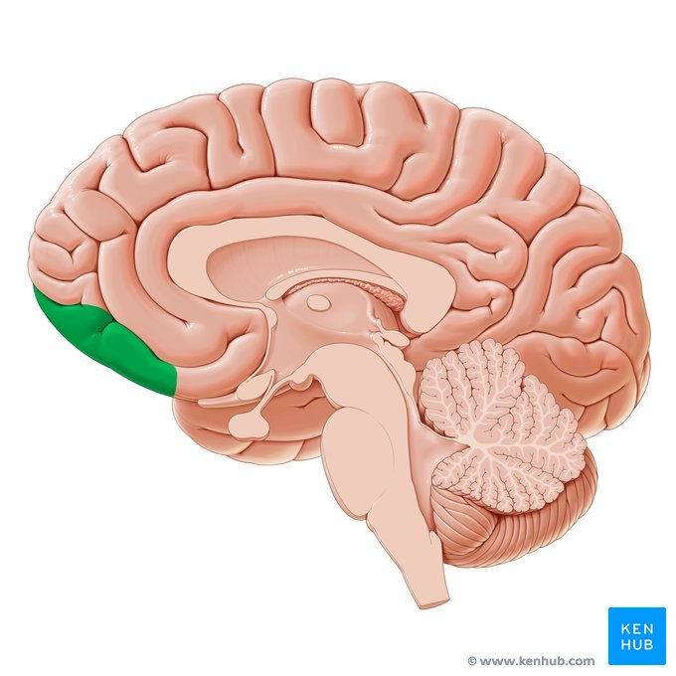



Recap
Experienced Utility = Consumption + Surprise
at time of news
at time of consumption

